Slide 1
Decision Workshops
Giving you the tools to understand, plan and focus on the politics of decision making

Slide 2
The problem

Slide 3
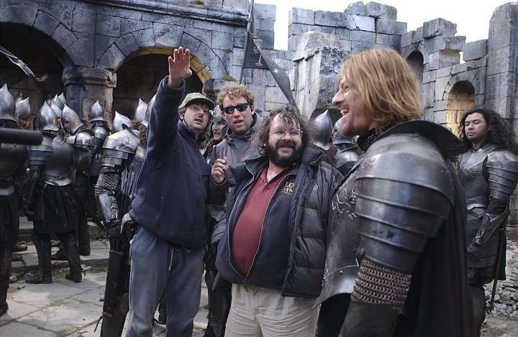
Actors always rehearse…

Slide 4
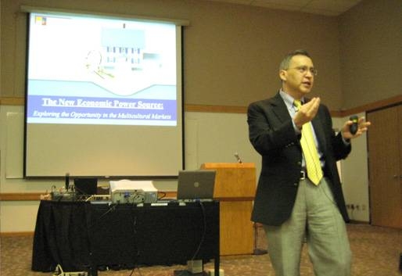
Presenters sometimes rehearse …

Slide 5
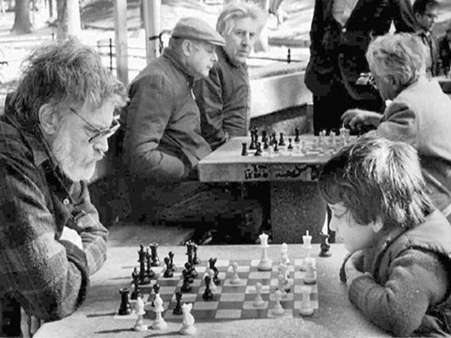
and we know that the more we rehearse and practice the more we improve….

Slide 6
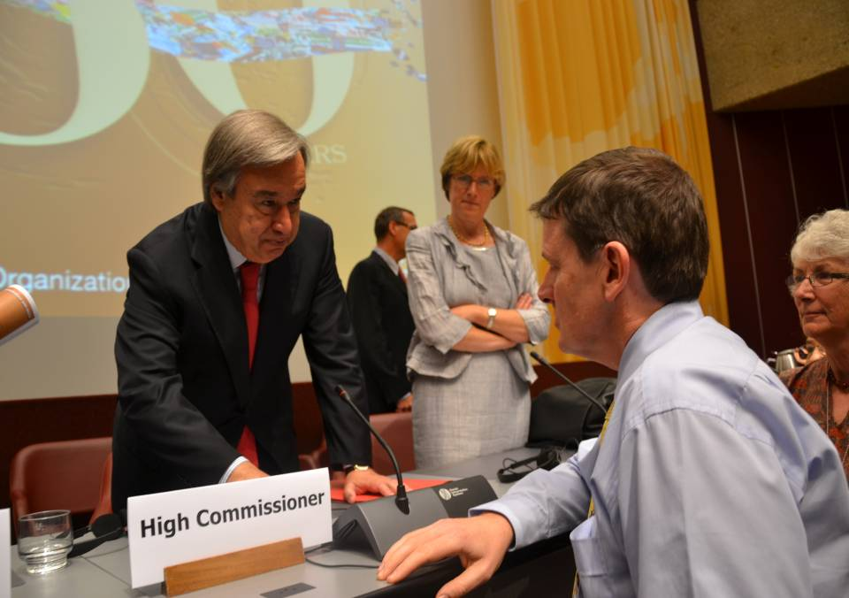
but we don’t properly rehearse the most important “political” interactions

Slide 7
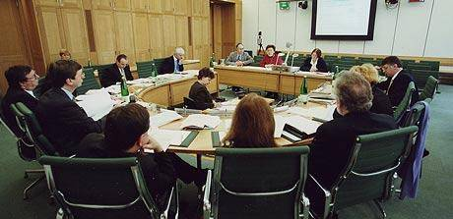
Instead there is a tendency to just rely on the unaided judgment of ourselves or of experts
Even though the experts often disagree with each other

Slide 8
But how good is this?

Slide 9
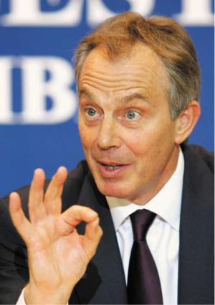
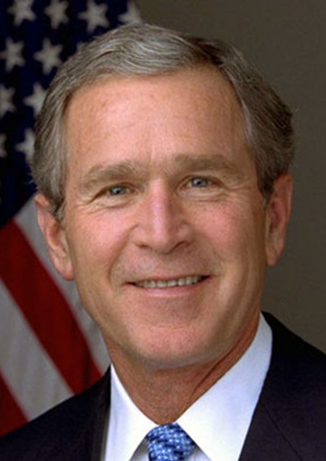
These people were not short of expert advisors when they chose to invade Iraq and Afghanistan
But had they thought through the consequences ?
Notes:
These gentlemen had a lot of experts to advise them, but they misjudged how others would behave.
Even with lots of advisors, they were still basically muddling through
So perhaps we should listen to others

Slide 10
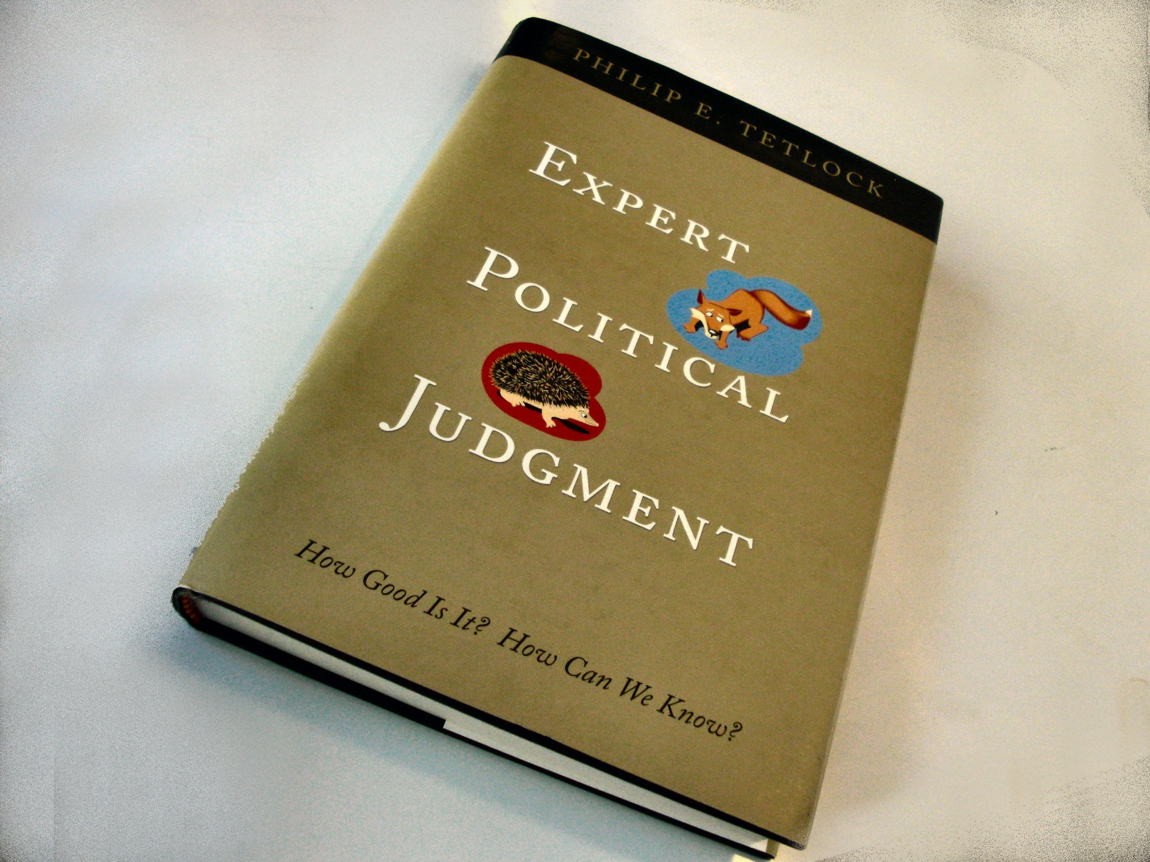
The scientific evidence is in:
Notes:
Philip E. Tetlock, now the Leonore Annenberg University Professor in Democracy and Citizenship at Penn, provided exceptional support for the Seer-Sucker Theory with his 2005 book, Expert Political Judgment. The book describes the findings from Tetlock’s 20-year study of 284 political and economic experts and their 82,361 forecasts during that time. As it turned out, the experts’ forecasts were no more accurate than those of novices

Slide 11
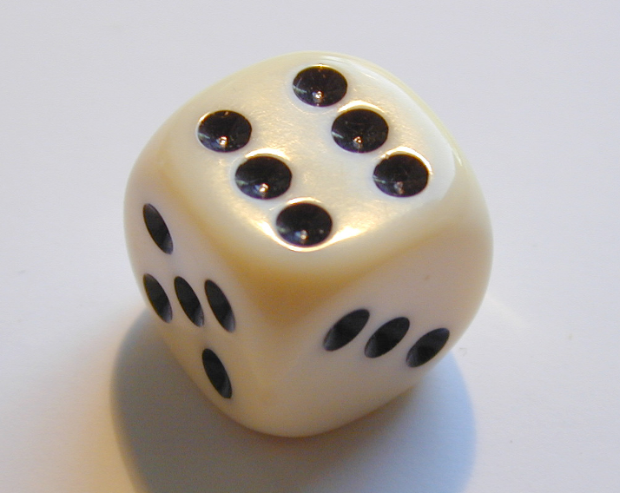
Using judgment for political decision making is
little better than random chance
See supporting evidence in Appendix at end of presentation

Slide 12
So what can be done?

Slide 13
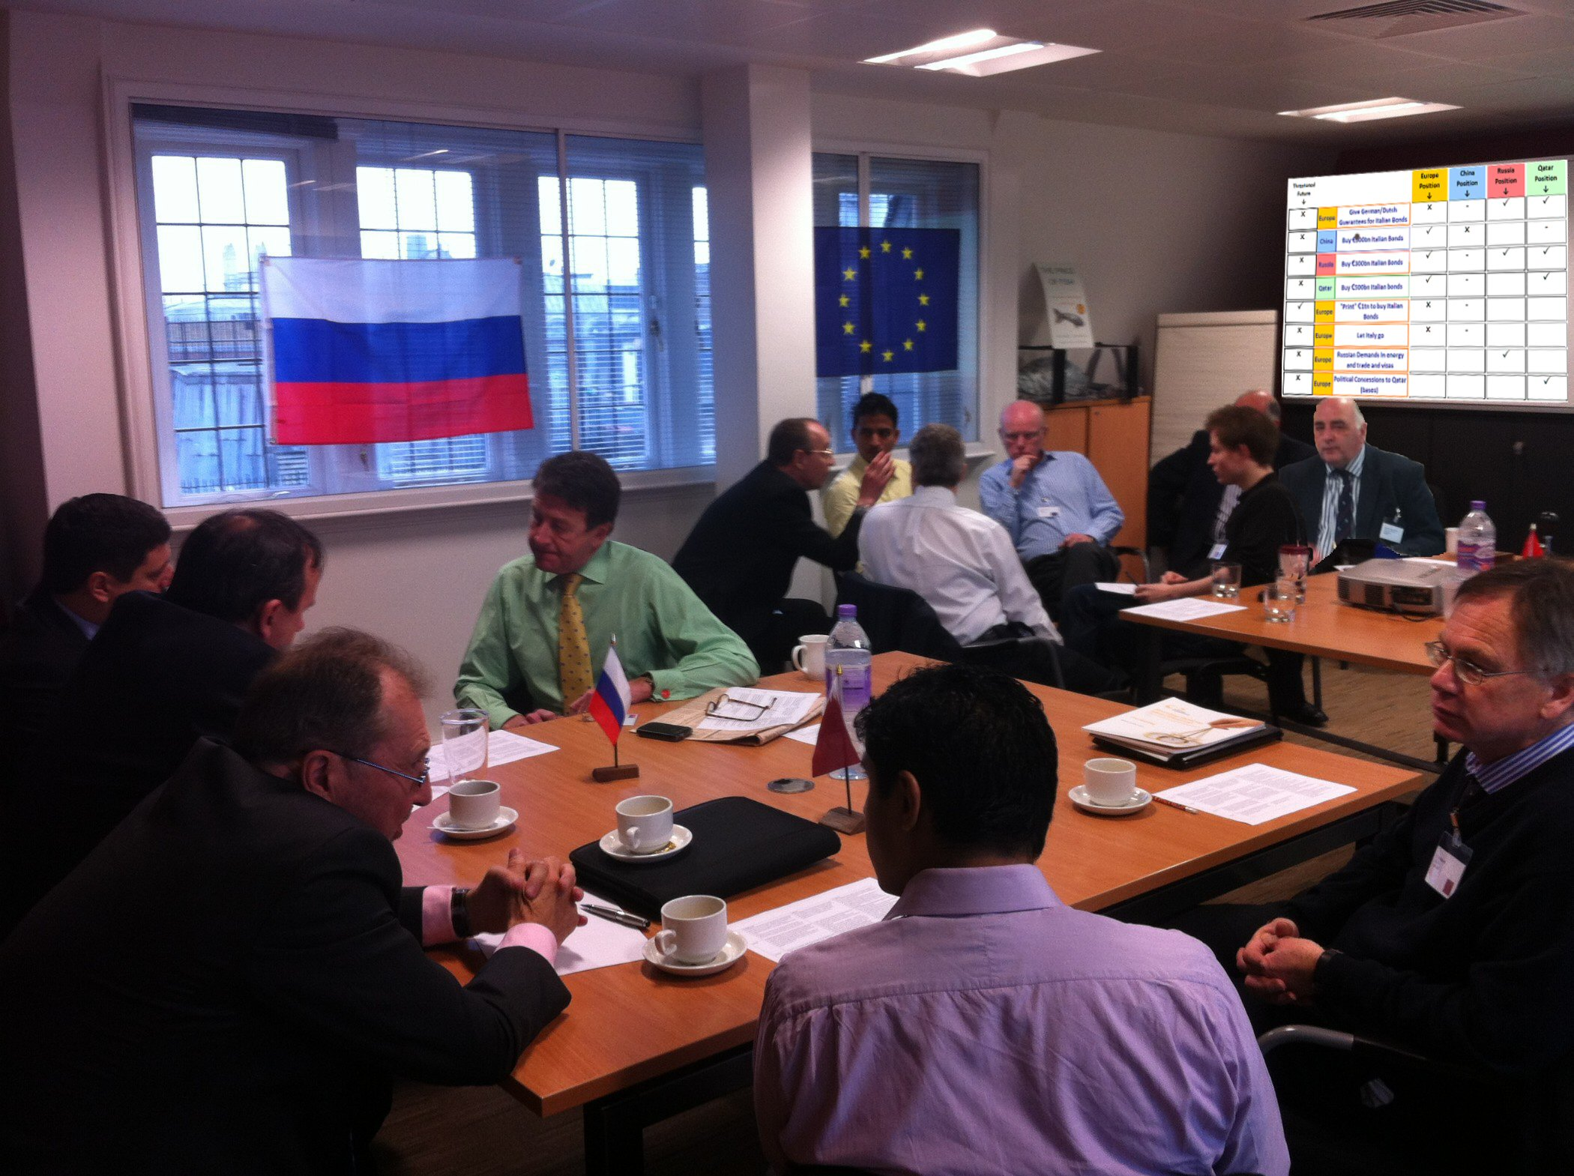
Decision workshops gives you a way to rehearse and plan these important political decisions.
By using Confrontation Analysis

Slide 14
Development of Confrontation Analysis

Slide 15
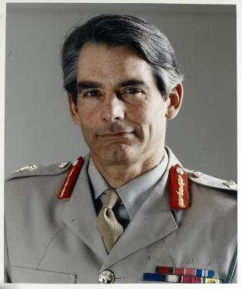
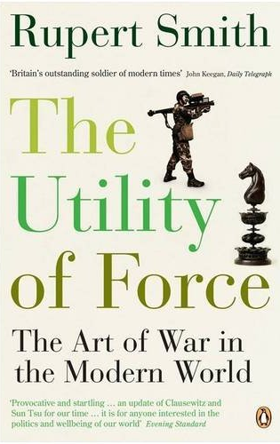
Bosnia 1995: Britain's last victorious war?
General Rupert Smith: Commander of UN forces in Bosnia:
Responsible for breaking siege of Sarajevo.
General Smith was not reluctant to tell people how he had succeeded
He wrote the book “The Utility of Force” and worked with….
General
Rupert Smith

Slide 16
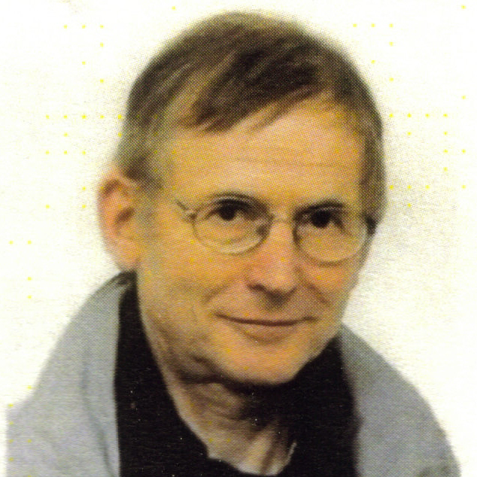
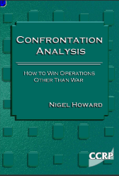
Working with Rupert Smith…
General
The Late Professor Nigel Howard
Who formulated Confrontation Analysis from basis of Game Theory.
Since Professor Howard’s death the theory has been picked up and developed by…
Rupert Smith

Slide 17
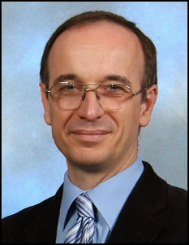
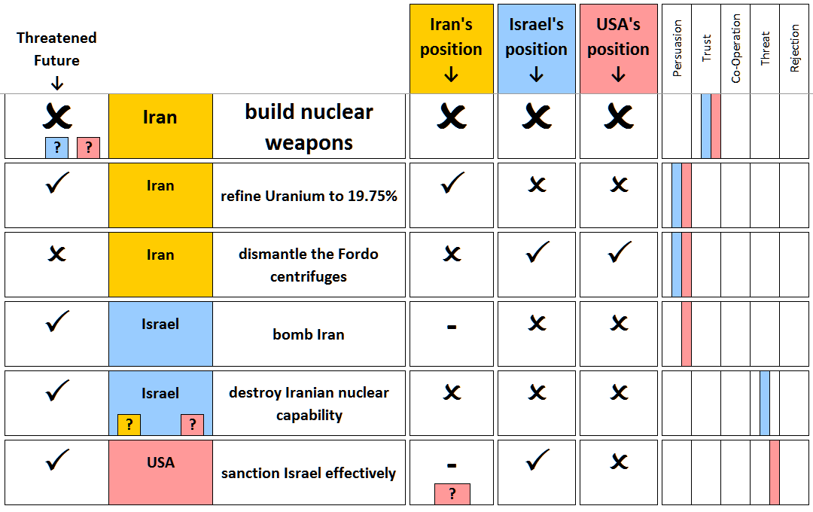
Carrying on the good work….
General
Mike Young
Who has refined and built on this theoretical framework and encapsulated it in the Dilemma Explorer program to produce a faster, easier and better means of exploring confrontations and rehearsing negotiations.
Rupert Smith

Slide 18
Our process
Building upon the foundations of the mathematical process of Confrontation Analysis, Decision Workshops has developed a unique modelling method and a proprietary software tool to that can analyse complex, multiplayer issues.

Slide 19
Our process
Define the problem
Define players, what they can do, and what they want to happen
Plan and develop strategy using Confrontation Analysis
Test and refine strategy in Decision Workshop
Present a clear focused strategy for action

Slide 20
The Dilemma Explorer program in action

Slide 21
The Dilemma Explorer program in action
Firstly, we help you understand the scenarios by structuring in important key decisions

Slide 22
The Dilemma Explorer program in action
And then gather an unambiguous clear statement of all parties’ desires

Slide 23
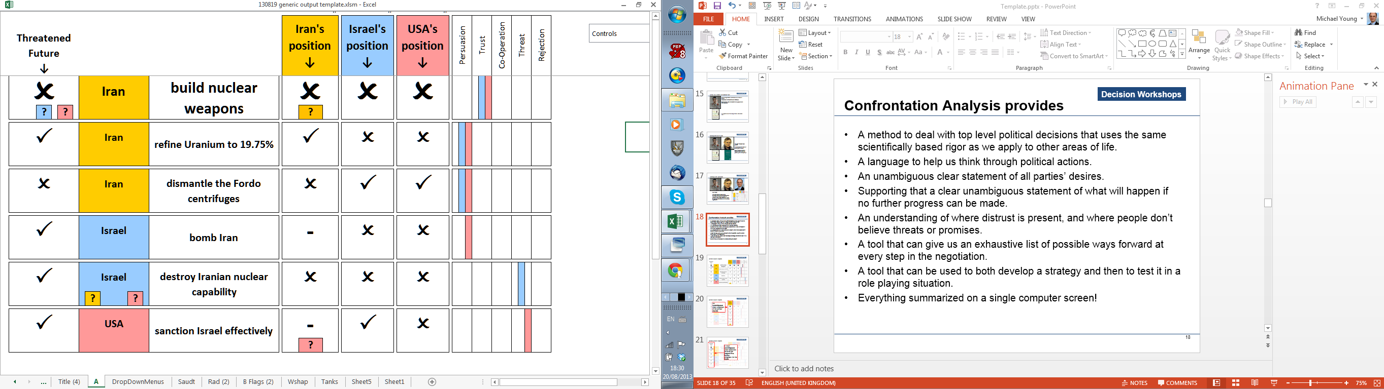
The Dilemma Explorer program in action
We then decide what will happen if no further progress can be made

Slide 24
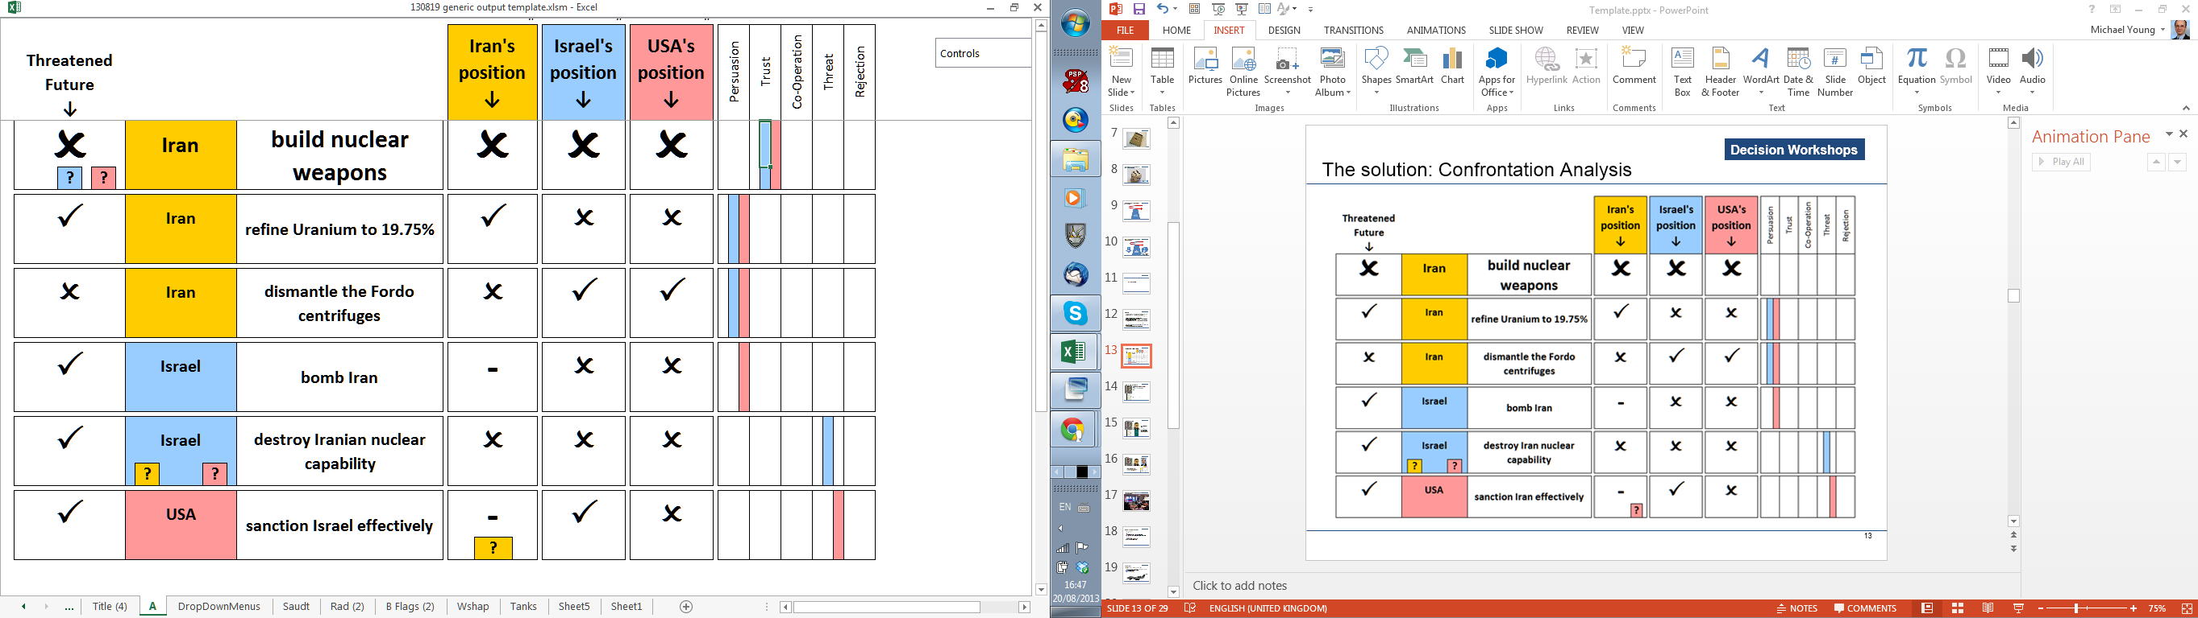
The Dilemma Explorer program in action
And indicate where distrust is present and where people don’t believe threats or promises

Slide 25
The Dilemma Explorer program in action
To produce a succinct one screen summary of the situation

Slide 26
The Dilemma Explorer program in action
The computer then automatically shows the areas of difficulty known as DILEMMAS that must be eliminated to get a trustworthy agreement

Slide 27
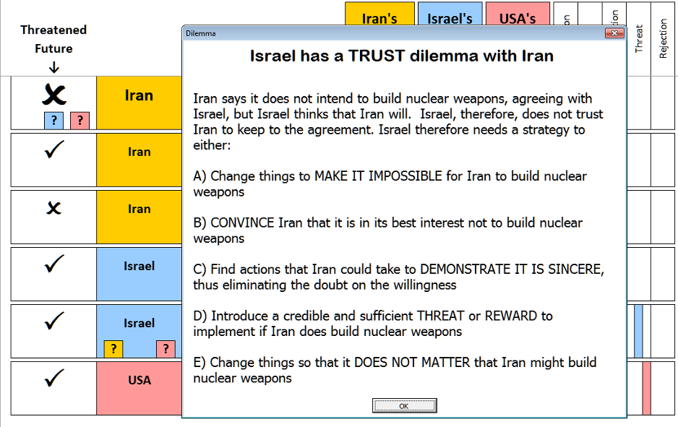
The Dilemma Explorer program in action
And can give an exhaustive list of possible ways forward to eliminate each dilemma

Slide 28
The participants use the program on the screen during the negotiation rehearsal to:
Keep focus on the subject under negotiation
Give a clear language in which to communicate
Understand the dilemmas and powers of each participant
Indicate when progress has been made by changing the screen
Look for different strategies out of an impasse

Slide 29
Decision Workshops track record

Slide 30
Decision Workshops held
Libya during the war :
  For Cranfield University
Libya at the end of the war :
  For Defence Science and Technology Laboratories
Iran Israel and the USA: Dealing with the Iranian Nuclear threat :
  For Cranfield University
  Follow-on workshop for Defence Intelligence Services
The Euro crisis:
  For city of London think tank Z/Yen
(Pending) Middle East government: Examining Sunni / Shia split

Slide 31
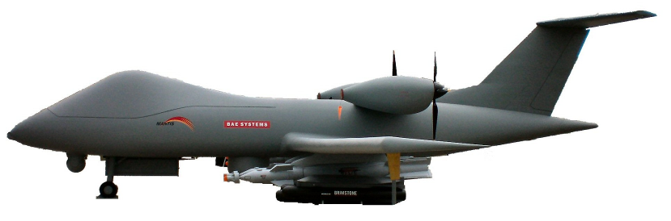
Business deals
For BAE Systems: 19 projects including:
  Getting funding from UK MoD for an unmanned aircraft (Mantis)
  Impact of Strategic Defence Reviews
  A400M project (twice)
  Partnering deals for bids

Slide 32
Testimonial
“The technology is simple but the underlying psychology, appealing to the individual’s natural will to win, mirroring real business behaviours, is truly and very powerfully innovative.”
Air Vice Marshal Steve Nicholl (Ret’d): Director Military Requirements, BAE Systems

Slide 33
Summary
Tried, tested, powerful and unique system.
Structured way of rehearsing negotiations and likely outcomes.
High probability of behaviours reflecting reality, enabling cost-effective decision making and the efficient use and deployment of resources.
Useful for government, military, commercial & individual applications.

Slide 34
Appendix: Evidence to support the benefits of role play

Slide 35
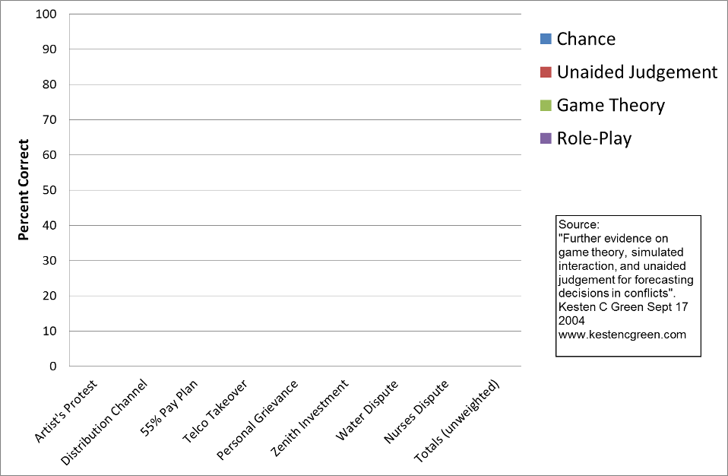
How good are we at forecasting how others will behave in conflicts?
Obscure conflicts
Notes:
Here is an experiment that was done. At the bottom here we have a selection of different situations, they are all things that actually happened, but they are quite obscure and disguised Here’s an artist’s protest, A fight about TV channel distributions, A Takeover, do I invest, A Takeover, and a Nurses dispute. Now each of these situations actually happened, we know the outcome. So what we did was took the real outcome, and mixed it with other things that may have happened, as a multiple choice test and then saw how good we are at predicting what will happen,

Slide 36
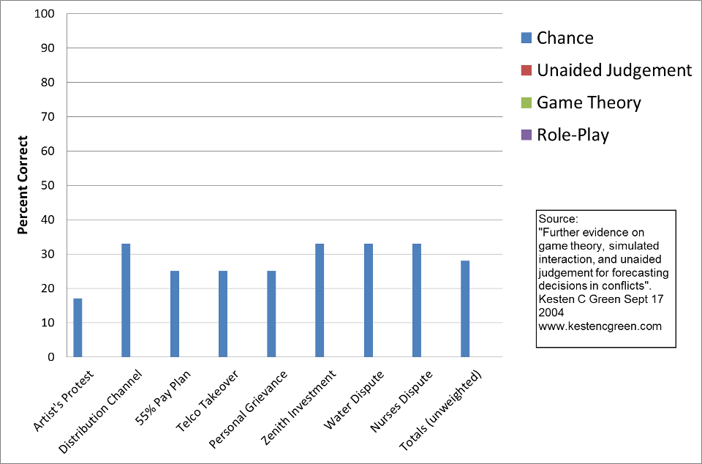
What we would expect from random chance ?
3 possible answers:
33% probability of getting it right by guessing
Average
6 answers
=17%
4 answers =25%
Notes:
Now because this is a multiple choice test, you can often get the right result, just by guessing, there’s six choices for artist’s protest, 1 in 6 chance of getting it right by guessing, three for the distribution channel, one in three chance of guessing and so on.
So (on average) we would expect to get about 27% right just by guessing. Let’s see how we did using other methods.

Slide 37
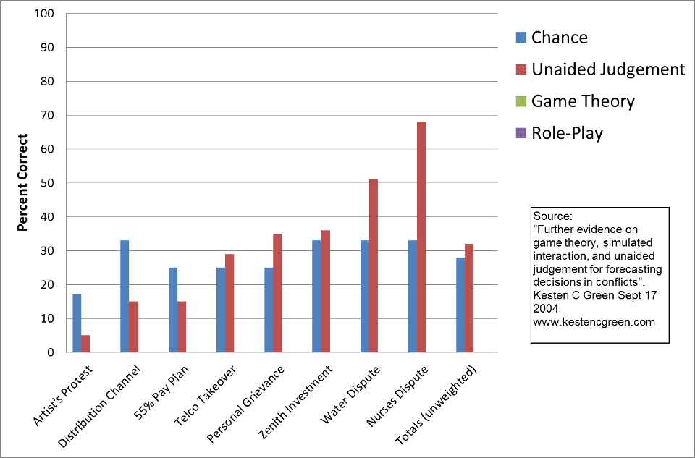
Using judgment is often WORSE then guessing !
Average
Notes:
FIRSTLY Unaided judgement. Nearly all decision making is of this form. If we just tell people to estimate what happens we get this….
We do worse than guessing some of the time, better at others, but on average, we do miserably, Hardly better than guessing,

Slide 38
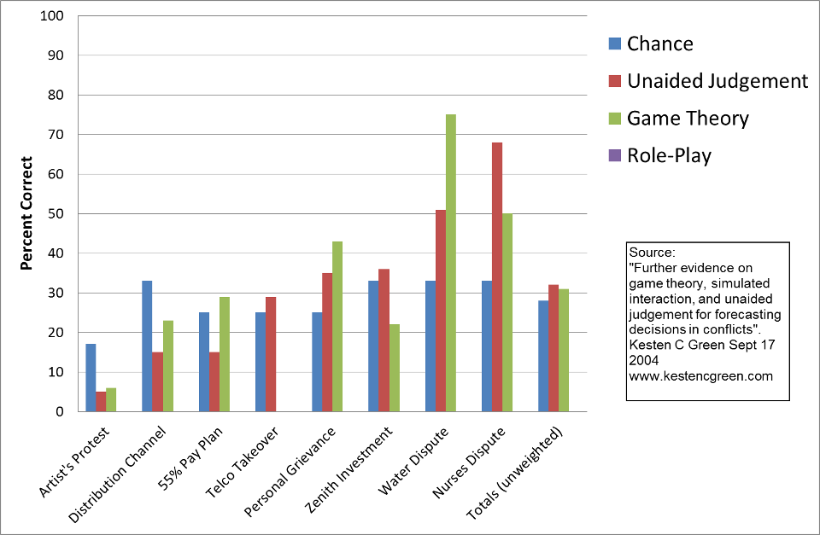
Using Game Theory fares no better..
Average
Notes:
SECONDLY
If we use mathematical techniques such as Game Theory to predict the outcome, we do even works that with unaided judgment. This would have been better if the participants had not scored 0 on the “Telco takeover” package.

Slide 39
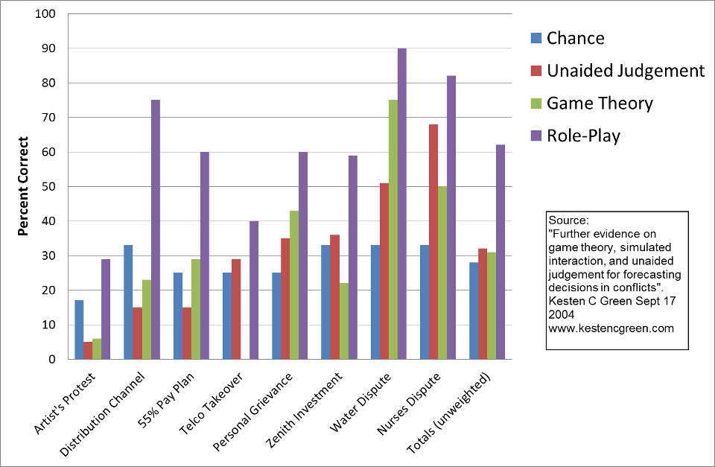
But a role play achieves substantially better forecasts
Average
Back
Notes:
THIRDLY
If we use role play we do much better. Role playing does seem to be able to predict the outcome of negotiations.

